Slide 1
Data Warehouse - Architecture

Slide 2
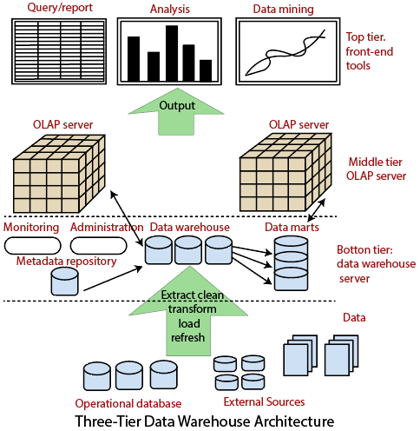

Slide 3
Three-Tier Data Warehouse Architecture
Data Warehouses usually have a three-level (tier) architecture that includes:
Bottom Tier (Data Warehouse Server)
Middle Tier (OLAP Server)
Top Tier (Front end Tools).

Slide 4
1. Bottom Tier
Consists of the Data Warehouse server, which is almost always an RDBMS.
It includes several specialized data marts and a metadata repository.
Data from operational databases and external sources (such as user profile data provided by external consultants) are extracted using application program interfaces called a gateway.
A gateway is provided by the underlying DBMS and allows customer programs to generate SQL code to be executed at a server.
Example gateways : ODBC (Open Database Connection) and OLE-DB (Open-Linking and Embedding for Databases), by Microsoft, and JDBC (Java Database Connection).

Slide 5
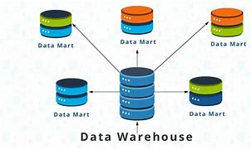
Data Mart & Metadata Repository
A data mart includes a subset of corporate-wide data that is of value to a specific collection of users.
For example, a marketing data mart may restrict its subjects to the customer, items, and sales.
The data contained in the data marts tend to be summarized.
Metadata is data about the data or documentation about the information which is required by the users. Includes
The location and descriptions of warehouse systems and components.
Names, definitions, structures, and content of data-warehouse and end-users views.
Integration and transformation rules used to populate data.
Security authorizations, access control list, etc

Slide 6
2. Middle-tier
A middle-tier which consists of an OLAP server for fast querying of the data warehouse.
The OLAP server is implemented using either
(1) A Relational OLAP (ROLAP) model, i.e., an extended relational DBMS that maps functions on multidimensional data to standard relational operations.
(2) A Multidimensional OLAP (MOLAP) model, i.e., a particular purpose server that directly implements multidimensional information and operations.

Slide 7
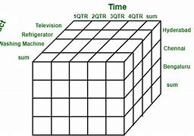
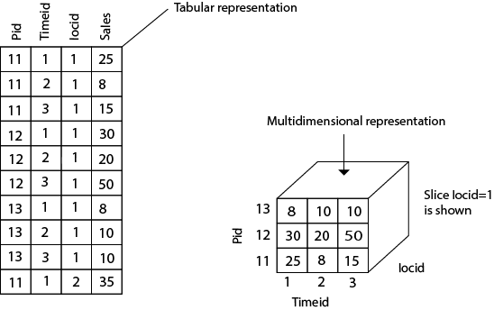
A multidimensional model views data in the form of a data-cube.
A data cube enables data to be modeled and viewed in multiple dimensions.
It is defined by dimensions and facts.

Slide 8
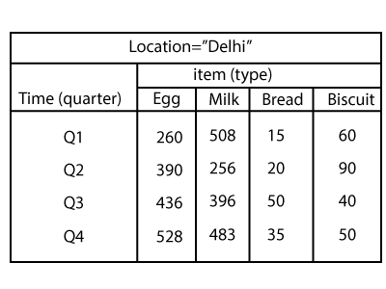
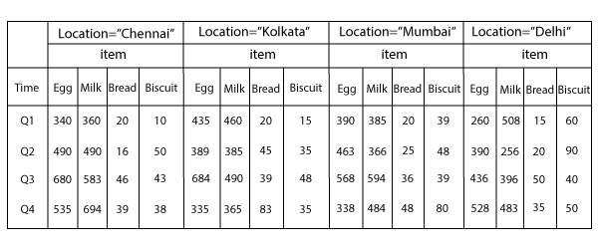
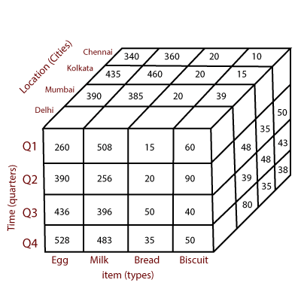

Slide 9
3. Top-tier
A top-tier that contains front-end tools for displaying results provided by OLAP, as well as additional tools for data mining of the OLAP-generated data.

Slide 10
Data Warehouse Models

Slide 11
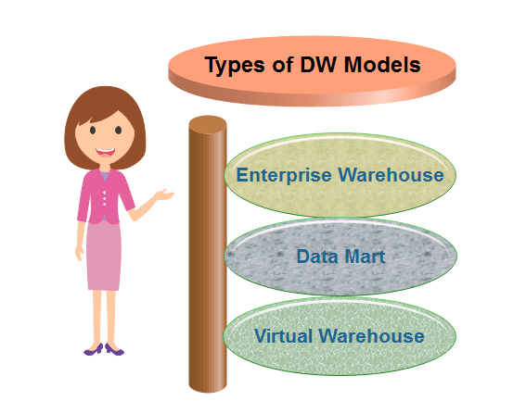
Types of Data Warehouse Models
Enterprise Warehouse
Data Mart
Virtual Warehouses

Slide 12
Enterprise Warehouse
An Enterprise warehouse collects all of the records about subjects spanning the entire organization.
It supports corporate-wide data integration, usually from one or more operational systems or external data providers, and it's cross-functional in scope.
It generally contains detailed information as well as summarized information and can range in estimate from a few gigabyte to hundreds of gigabytes, terabytes, or beyond.
An enterprise data warehouse may be accomplished on traditional mainframes, UNIX super servers, or parallel architecture platforms.
It required extensive business modeling and may take years to develop and build.

Slide 13
Data Mart
A data mart includes a subset of corporate-wide data that is of value to a specific collection of users.
The scope is confined to particular selected subjects.
For example, a marketing data mart may restrict its subjects to the customer, items, and sales. The data contained in the data marts tend to be summarized.
Data Marts is divided into two parts:
Independent Data Mart: Independent data mart is sourced from data captured from one or more operational systems or external data providers, or data generally locally within a different department or geographic area.
Dependent Data Mart: Dependent data marts are sourced exactly from enterprise data-warehouses.

Slide 14
Virtual Warehouses
Virtual Data Warehouses is a set of perception over the operational database.
For effective query processing, only some of the possible summary vision may be materialized.
A virtual warehouse is simple to build but required excess capacity on operational database servers.

Slide 15
ETL (Extract, Transform, and Load) Process
ETL - Extraction, Transformation and Loading.
The mechanism of extracting information from source systems and bringing it into the data warehouse
The ETL process requires active inputs from various stakeholders, including developers, analysts, testers, top executives and is technically challenging.
To maintain its value as a tool for decision-makers, Data warehouse technique needs to change with business changes.
ETL is a recurring method (daily, weekly, monthly) of a Data warehouse system and needs to be agile, automated, and well documented.

Slide 16
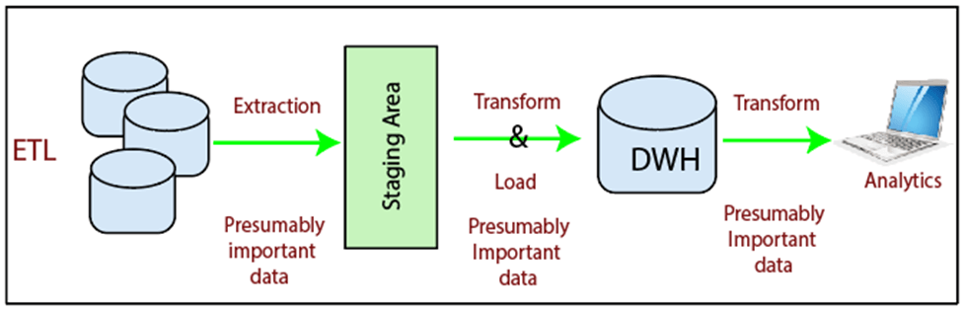
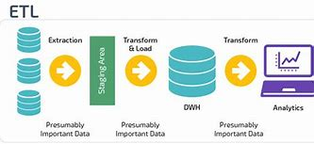

Slide 17
ETL Works?
ETL consists of three separate phases:
1. Extraction
2. Transformation
3. Loading
Extraction
Extraction is the operation of extracting information from a source system for further use in a data warehouse environment.
Extraction process is often one of the most time-consuming tasks in the ETL.
The source systems might be complicated and poorly documented, and thus determining which data needs to be extracted can be difficult.
The data has to be extracted several times in a periodic manner to supply all changed data to the warehouse and keep it up-to-date.

Slide 18
Cleansing
The cleansing stage is crucial in a - it is supposed to improve data quality.
The primary data cleansing features found in ETL tools are rectification and homogenization.
They use specific dictionaries to rectify typing mistakes and to recognize synonyms, as well as rule-based cleansing to enforce domain-specific rules and defines appropriate associations between values.
If an enterprise wishes to contact its users or its suppliers, a complete, accurate and up-to-date list of contact addresses, email addresses and telephone numbers must be available.
If a client or supplier calls, the staff responding should be quickly able to find the person in the enterprise database, but this need that the caller's name or his/her company name is listed in the database.
If a user appears in the databases with two or more slightly different names or different account numbers, it becomes difficult to update the customer's information.

Slide 19
Transformation
Transformation is the core of the reconciliation phase.
It converts records from its operational source format into a particular data warehouse format.
The following points must be rectified in this phase:
Loose texts may hide valuable information.
For example, XYZ PVT Ltd does not explicitly show that this is a Limited Partnership company.
Different formats can be used for individual data.
For example, data can be saved as a string or as three integers.

Slide 20
The main transformation processes aimed at populating the reconciled data layer:
Conversion and normalization that operate on both storage formats and units of measure to make data uniform.
Matching that associates equivalent fields in different sources.
Selection that reduces the number of source fields and records.
Cleansing and Transformation processes are often closely linked in ETL tools.

Slide 21
Loading
The Load is the process of writing the data into the target database.
During the load step, it is necessary to ensure that the load is performed correctly and with as little resources as possible.
Loading can be carried in two ways:
Refresh:
Data Warehouse data is completely rewritten - the older file is replaced.
Refresh is usually used in combination with static extraction to populate a data warehouse initially.
Update:
Only those changes applied to source information are added to the Data Warehouse.
An update is typically carried out without deleting or modifying preexisting data.
This method is used in combination with incremental extraction to update data warehouses regularly.

Slide 22
Meta Data

Slide 23
Meta Data
Metadata is data about the data or documentation about the information which is required by the users.
Metadata includes the following:
The location and descriptions of warehouse systems and components.
Names, definitions, structures, and content of data-warehouse and end-users views.
Identification of authoritative data sources.
Integration and transformation rules used to populate data.
Integration and transformation rules used to deliver information to end-user analytical tools.
Subscription information for information delivery to analysis subscribers.
Metrics used to analyze warehouses usage and performance.
Security authorizations, access control list, etc.
Metadata is used for building, maintaining, managing, and using the data warehouses. Metadata allow users access to help understand the content and find data.

Slide 24
Data Mart

Slide 25
Data Mart
A Data Mart is a subset of a directorial information store, generally oriented to a specific purpose or primary data subject which may be distributed to provide business needs.
Data Marts are analytical record stores designed to focus on particular business functions for a specific community within an organization.
The fundamental use of a data mart is Business Intelligence (BI) applications.
BI is used to gather, store, access, and analyze record.
It can be used by smaller businesses to utilize the data they have accumulated since it is less expensive than implementing a data warehouse.

Slide 26
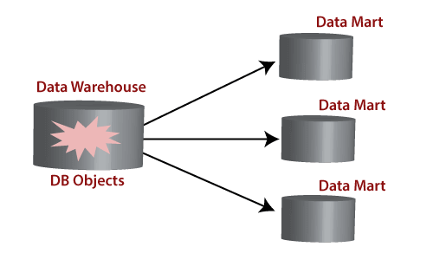
Reasons for creating a data mart
Creates collective data by a group of users
Easy access to frequently needed data
Ease of creation
Improves end-user response time
Lower cost than implementing a complete data warehouses
Potential clients are more clearly defined than in a comprehensive data warehouse
It contains only essential business data and is less cluttered.
Types of Data Marts
There are mainly two approaches to designing data marts. These approaches are
Dependent Data Marts
Independent Data Marts

Slide 27
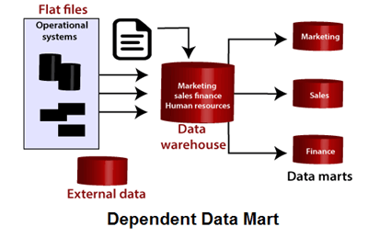
Dependent Data Marts
A dependent data marts is a logical subset of a physical subset of a higher data warehouse.
Firstly a data warehouse is created from which further various data marts can be created.
These data mart are dependent on the data warehouse and extract the essential record from it.
As the data warehouse creates the data mart; therefore, there is no need for data mart integration.
It is a top-down approach.

Slide 28
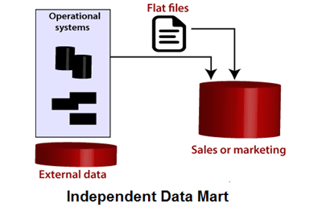
Independent Data Marts
Firstly independent data marts are created, and then a data warehouse is designed using these independent multiple data marts.
As all the data marts are designed independently; therefore, the integration of data marts is required.
It is a bottom-up approach as the data marts are integrated to develop a data warehouse.

Slide 29
Data Warehouse vs Data Mart
Data Warehouse | Data Mart
A Data Warehouse is a vast repository of information collected from various organizations or departments within a corporation. | A data mart is an only subtype of a Data Warehouses. It is architecture to meet the requirement of a specific user group.
It may hold multiple subject areas. | It holds only one subject area. For example, Finance or Sales.
It holds very detailed information. | It may hold more summarized data.
Works to integrate all data sources | It concentrates on integrating data from a given subject area or set of source systems.
In data warehousing, Fact constellation is used. | In Data Mart, Star Schema and Snowflake Schema are used.
It is a Centralized System. It is a Decentralized System.
Data Warehousing is the data-oriented. | Data Marts is a project-oriented.

Slide 31
Data Modeling: - Dimensional Modeling
Dimensional modeling represents data with a cube operation, making more suitable logical data representation with OLAP data management.
The perception of Dimensional Modeling was developed by Ralph Kimball and is consist of "fact" and "dimension" tables.
In dimensional modeling, the transaction record is divided into either "facts," which are frequently numerical transaction data, or "dimensions," which are the reference information that gives context to the facts.
Example
a sale transaction can be damage into facts such as the number of products ordered and the price paid for the products, and into dimensions such as order date, user name, product number, order ship-to, and bill-to locations, and salesman responsible for receiving the order.

Slide 32
Objectives of Dimensional Modeling
The purposes of dimensional modeling are:
To produce database architecture that is easy for end-clients to understand and write queries.
To maximize the efficiency of queries. It achieves these goals by minimizing the number of tables and relationships between them.

Slide 33
Elements of Dimensional Modeling
Fact
It is a collection of associated data items, consisting of measures and context data. It typically represents business items or business transactions.
Dimensions
It is a collection of data which describe one business dimension. Dimensions decide the contextual background for the facts, and they are the framework over which OLAP is performed.
Measure
It is a numeric attribute of a fact, representing the performance or behavior of the business relative to the dimensions.

Slide 34
There are two basic models which are used in dimensional modeling:
Star Model
The star model is the underlying structure for a dimensional model. It has one broad central table (fact table) and a set of smaller tables (dimensions) arranged in a radial design around the primary table.
Snowflake Model
The snowflake model is the conclusion of decomposing one or more of the dimensions.

Slide 35
Fact Table
Fact tables are used to data facts or measures in the business. Facts are the numeric data elements that are of interest to the company.
Characteristics of the Fact table
The fact table includes numerical values of what we measure. For example, a fact value of 20 might means that 20 widgets have been sold.
Each fact table includes the keys to associated dimension tables. These are known as foreign keys in the fact table.
Fact tables typically include a small number of columns.
When it is compared to dimension tables, fact tables have a large number of rows.

Slide 36
Dimension Table
Dimension tables establish the context of the facts. Dimensional tables store fields that describe the facts.
Characteristics of the Dimension table
Dimension tables contain the details about the facts. That, as an example, enables the business analysts to understand the data and their reports better.
The dimension tables include descriptive data about the numerical values in the fact table. That is, they contain the attributes of the facts. For example, the dimension tables for a marketing analysis function might include attributes such as time, marketing region, and product type.
Since the record in a dimension table is denormalized, it usually has a large number of columns. The dimension tables include significantly fewer rows of information than the fact table.
The attributes in a dimension table are used as row and column headings in a document or query results display.

Slide 37
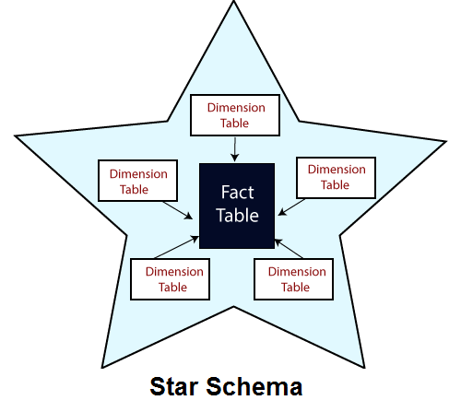
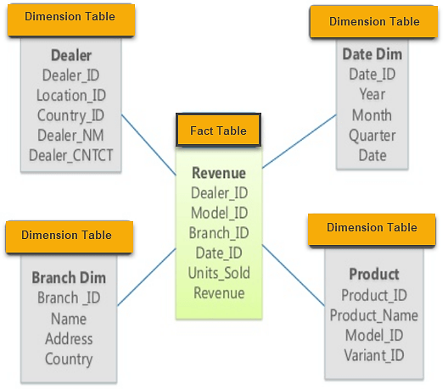
center of the star can have one fact table and a number of associated dimension tables

Slide 38
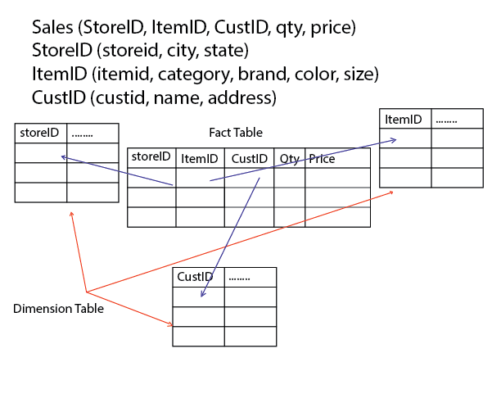
Example:
A city and state can view a store summary in a fact table. Item summary can be viewed by brand, color, etc. Customer information can be viewed by name and address.

Slide 39
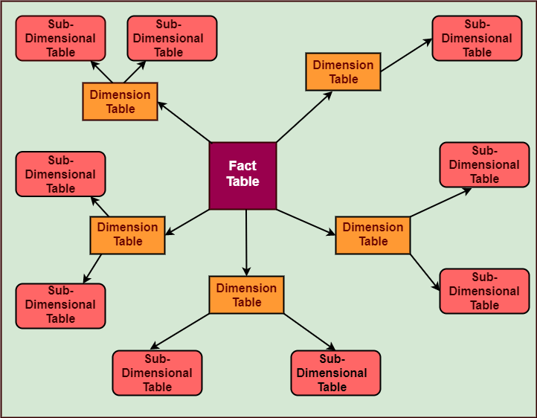
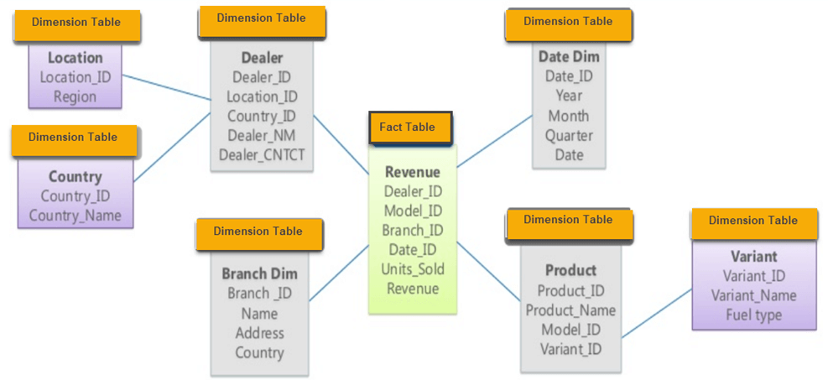
Snowflake Schema
A snowflake schema is an extension of star schema.
it adds additional dimensions.
"A schema is known as a snowflake if one or more dimension tables do not connect directly to the fact table but must join through other dimension tables."
It is called snowflake schema because the diagram of snowflake schema resembles a snowflake.

Slide 40
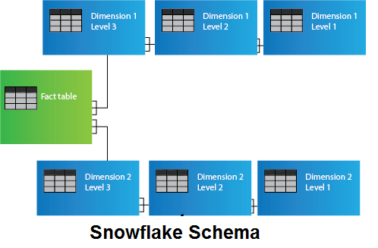
The following diagram shows a snowflake schema with two dimensions, each having three levels. A snowflake schemas can have any number of dimension, and each dimension can have any number of levels.

Slide 41
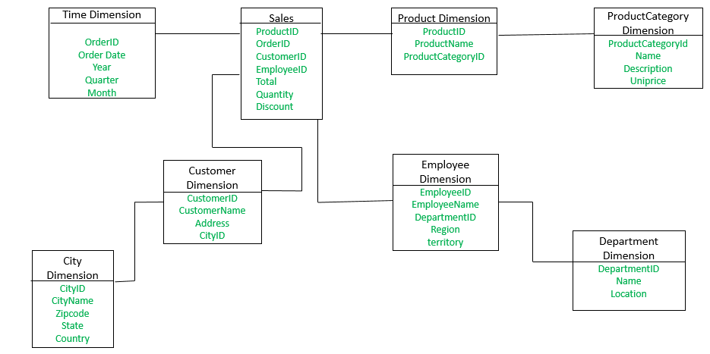
Example: The Employee dimension table now contains the attributes: EmployeeID, EmployeeName, DepartmentID, Region, Territory. The DepartmentID attribute links with the Employee table with the Department dimension table. The Department dimension is used to provide detail about each department, such as the Name and Location of the department. The Customer dimension table now contains the attributes: CustomerID, CustomerName, Address, CityID. The CityID attributes link the Customer dimension table with the City dimension table. The City dimension table has details about each city such as CityName, Zipcode, State, and Country.

Slide 42
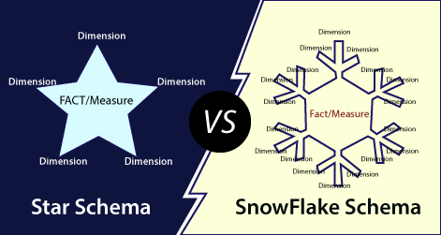

Slide 43
Fact Table
Time ID | Product ID | Customer ID | Unit Sold
4 | 17 | 2 | 1
8 | 21 | 3 | 2
8 | 4 | 1 | 1

Slide 44
Dimension Tables
Hierarchy
A hierarchy is a directed tree whose nodes are dimensional attributes and whose arcs model many to one association between dimensional attributes team. It contains a dimension, positioned at the tree's root, and all of the dimensional attributes that define it.
Customer ID | Name | Gender | Income | Education | Region
1 | Rohan | Male | 2 | 3 | 4
2 | Sandeep | Male | 3 | 5 | 1
3 | Gaurav | Male | 1 | 7 | 3

Slide 45
Multi-Dimensional Data Model
A multidimensional model views data in the form of a data-cube. A data cube enables data to be modeled and viewed in multiple dimensions. It is defined by dimensions and facts.
The dimensions are the perspectives or entities concerning which an organization keeps records.
Example
Shop may create a sales data warehouse to keep records of the store's sales for the dimension time, item, and location.
These dimensions allow the save to keep track of things, for example, monthly sales of items and the locations at which the items were sold.
Each dimension has a table related to it, called a dimensional table, which describes the dimension further.
Example
Dimensional table for an item may contain the attributes item name, brand, and type.
A multidimensional data model is organized around a central theme, for example, sales. This theme is represented by a fact table.
Facts are numerical measures. The fact table contains the names of the facts or measures of the related dimensional tables.

Slide 46

Consider the data of a shop for items sold per quarter in the city of Delhi. The data is shown in the table.
In this 2D representation, the sales for Delhi are shown for the time dimension (organized in quarters) and the item dimension (classified according to the types of an item sold). The fact or measure displayed in rupee sold (in thousands).

Slide 47


Now, want to view the sales data with a third dimension, For example, suppose the data according to time and item, as well as the location is considered for the cities Chennai, Kolkata, Mumbai, and Delhi.
These 3D data are shown in the table. The 3D data of the table are represented as a series of 2D tables.

Slide 48

Conceptually, it may also be represented by the same data in the form of a 3D data cube,

Slide 49
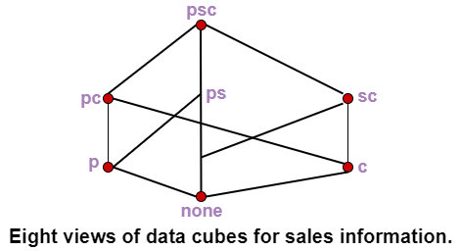
Data Cube
Data is grouped or combined in multidimensional matrices called Data Cubes.
The data cube method has a few alternative names or a few variants, such as "Multidimensional databases," "materialized views," and "OLAP (On-Line Analytical Processing)."
Idea is to materialize certain expensive computations that are frequently inquired.
Example
Relation with the schema sales (part, supplier, customer, and sale-price) can be materialized into a set of eight views as shown in fig, where psc indicates a view consisting of aggregate function value (such as total-sales) computed by grouping three attributes part, supplier, and customer, p indicates a view composed of the corresponding aggregate function values calculated by grouping part alone, etc.

Slide 50
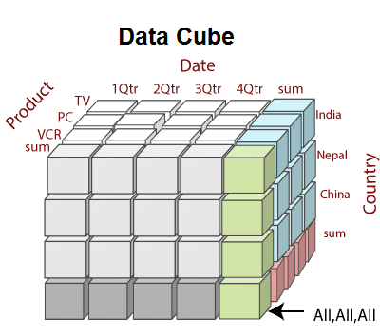
Dimensions are a fact that defines a data cube.
Facts are generally quantities, which are used for analyzing the relationship between dimensions.

Slide 51
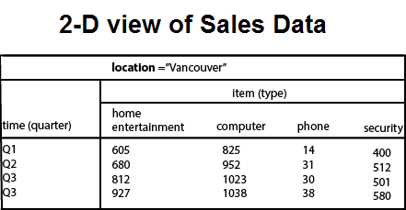
Example: In the 2-D representation, we will look at the All Electronics sales data for items sold per quarter in the city of Vancouver. The measured display in dollars sold (in thousands).

Slide 52
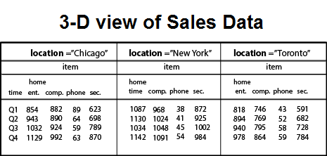
3-Dimensional Cuboids
Let suppose we would like to view the sales data with a third dimension. For example, suppose we would like to view the data according to time, item as well as the location for the cities Chicago, New York, Toronto, and Vancouver. The measured display in dollars sold (in thousands). These 3-D data are shown in the table. The 3-D data of the table are represented as a series of 2-D tables.

Slide 53
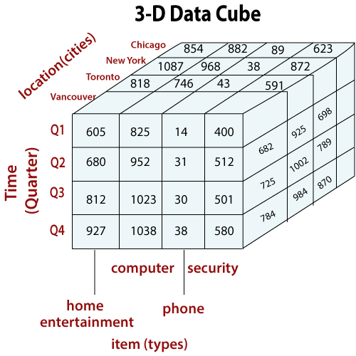
Conceptually, we may represent the same data in the form of 3-D data cubes, as shown in fig:

Slide 54
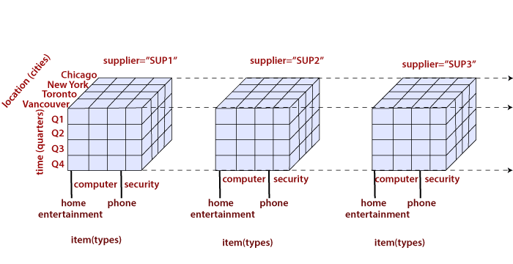
sales data with an additional fourth dimension, such as a supplier.
The data cubes are n-dimensional.
The cuboid which holds the lowest level of summarization is called a base cuboid.
For example, the 4-D cuboid in the figure is the base cuboid for the given time, item, location, and supplier dimensions.

Slide 55
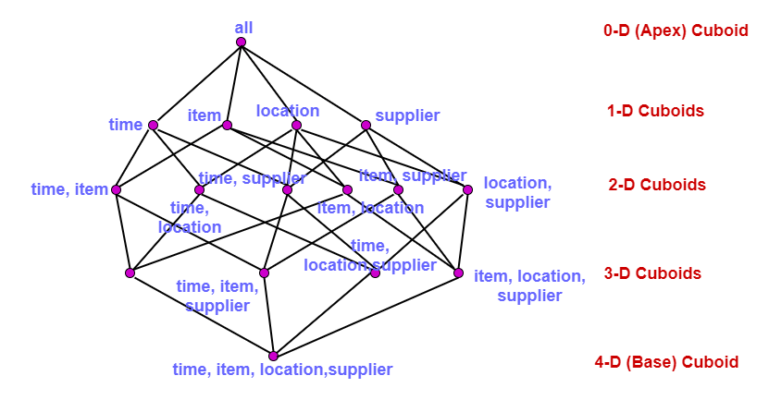
A 4-D data cube representation of sales data, according to the dimensions time, item, location, and supplier.
The measure displayed is dollars sold (in thousands).
The topmost 0-D cuboid, which holds the highest level of summarization, is known as the apex cuboid.
In this example, this is the total sales, or dollars sold, summarized over all four dimensions.
The lattice of cuboid forms a data cube.
Each cuboid represents a different degree of summarization.

Slide 56
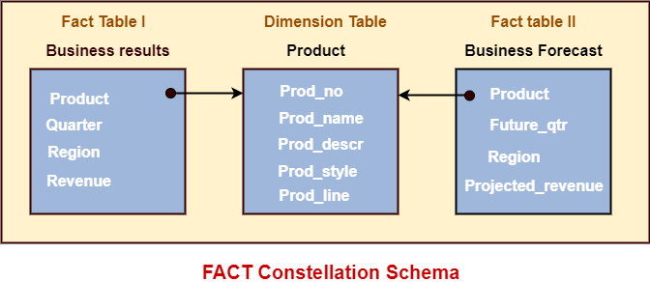
Fact Constellation Schema
A Fact constellation means two or more fact tables sharing one or more dimensions. It is also called Galaxy schema.
Fact Constellation Schema describes a logical structure of data warehouse or data mart. Fact Constellation Schema can design with a collection of de-normalized FACT, Shared, and Conformed Dimension tables.

Slide 57
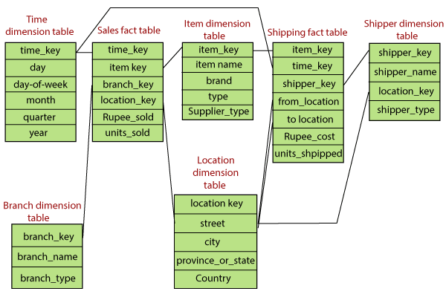
Fact Constellation Schema is a sophisticated database design that is difficult to summarize information. Fact Constellation Schema can implement between aggregate Fact tables or decompose a complex Fact table into independent simplex Fact tables.
Example: A fact constellation schema is shown in the figure below.

Slide 58
This schema defines two fact tables, sales, and shipping. Sales are treated along four dimensions, namely, time, item, branch, and location. The schema contains a fact table for sales that includes keys to each of the four dimensions, along with two measures: Rupee_sold and units_sold. The shipping table has five dimensions, or keys: item_key, time_key, shipper_key, from_location, and to_location, and two measures: Rupee_cost and units_shipped.
The primary disadvantage of the fact constellation schema is that it is a more challenging design because many variants for specific kinds of aggregation must be considered and selected.

Slide 59
OLAP Operations

Slide 60
OLAP Operations
Online Analytical Processing Server (OLAP) is based on the multidimensional data model.
It allows managers, and analysts to get an insight of the information through fast, consistent, and interactive access to information.
Types of OLAP Servers
We have four types of OLAP servers −
Relational OLAP (ROLAP)
Multidimensional OLAP (MOLAP)
Hybrid OLAP (HOLAP)
Specialized SQL Servers

Slide 61
OLAP Operations
Since OLAP servers are based on multidimensional view of data, the OLAP operations in multidimensional data are
Roll-up
Drill-down
Slice and dice
Pivot (rotate)

Slide 62
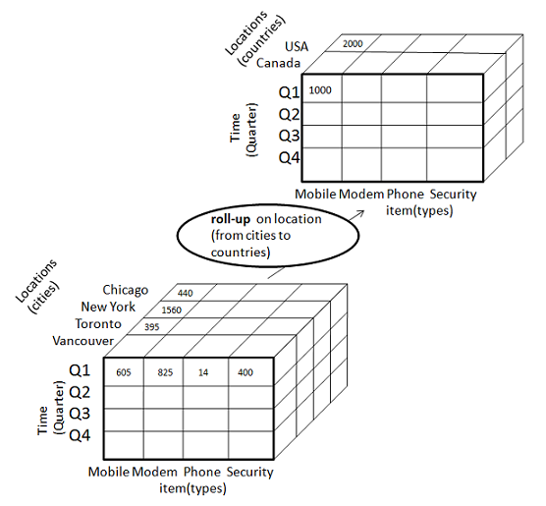
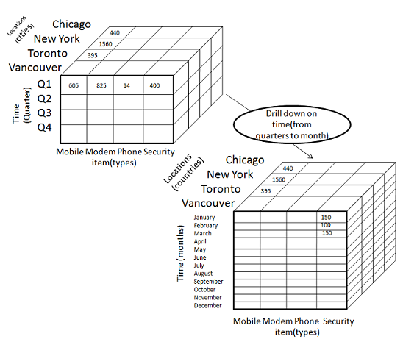

Slide 63
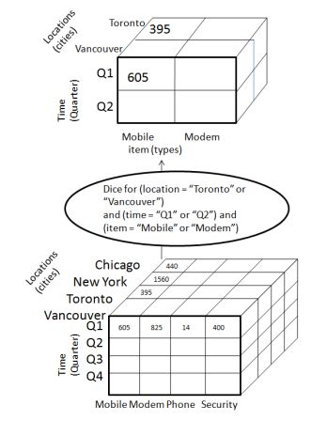
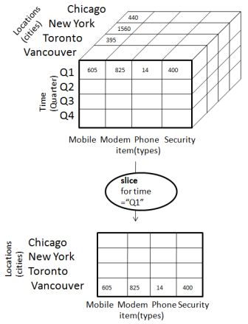

Slide 64

Roll-up
Roll-up performs aggregation on a data cube in any of the following ways −
By climbing up a concept hierarchy for a dimension
By dimension reduction

Slide 65
Roll-up is performed by climbing up a concept hierarchy for the dimension location.
Initially the concept hierarchy was "street < city < province < country".
On rolling up, the data is aggregated by ascending the location hierarchy from the level of city to the level of country.
The data is grouped into cities rather than countries.
When roll-up is performed, one or more dimensions from the data cube are removed.

Slide 66

Drill-down
Drill-down is the reverse operation of roll-up. It is performed by either of the following ways −
By stepping down a concept hierarchy for a dimension
By introducing a new dimension.

Slide 67
Drill-down is performed by stepping down a concept hierarchy for the dimension time.
Initially the concept hierarchy was "day < month < quarter < year."
On drilling down, the time dimension is descended from the level of quarter to the level of month.
When drill-down is performed, one or more dimensions from the data cube are added.
It navigates the data from less detailed data to highly detailed data.

Slide 68

Slice
The slice operation selects one particular dimension from a given cube and provides a new sub-cube.
Slice is performed for the dimension "time" using the criterion time = "Q1".
It will form a new sub-cube by selecting one or more dimensions.

Slide 69

Dice
Dice selects two or more dimensions from a given cube and provides a new sub-cube.
The dice operation on the cube based on the following selection criteria involves three dimensions.
(location = "Toronto" or "Vancouver")
(time = "Q1" or "Q2")
(item =" Mobile" or "Modem")

Slide 70
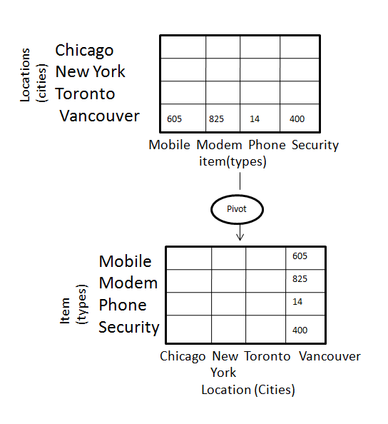
Pivot
The pivot operation is also known as rotation.
It rotates the data axes in view in order to provide an alternative presentation of data.

Slide 71
Design and usage
A data warehouse is a single data repository where a record from multiple data sources is integrated for online business analytical processing (OLAP).
This implies a data warehouse needs to meet the requirements from all the business stages within the entire organization.
Thus, data warehouse design is a hugely complex, lengthy, and hence error-prone process. Furthermore, business analytical functions change over time, which results in changes in the requirements for the systems.
Therefore, data warehouse and OLAP systems are dynamic, and the design process is continuous.
Data warehouse design takes a method different from view materialization in the industries. It sees data warehouses as database systems with particular needs such as answering management related queries. The target of the design becomes how the record from multiple data sources should be extracted, transformed, and loaded (ETL) to be organized in a database as the data warehouse.
There are two approaches
"top-down" approach
"bottom-up" approach

Slide 72
Top-down Design Approach
In the "Top-Down" design approach, a data warehouse is described as a subject-oriented, time-variant, non-volatile and integrated data repository for the entire enterprise data from different sources are validated, reformatted and saved in a normalized (up to 3NF) database as the data warehouse.
The data warehouse stores "atomic" information, the data at the lowest level of granularity, from where dimensional data marts can be built by selecting the data required for specific business subjects or particular departments.
An approach is a data-driven approach as the information is gathered and integrated first and then business requirements by subjects for building data marts are formulated.
The advantage of this method is which it supports a single integrated data source. Thus data marts built from it will have consistency when they overlap.

Slide 73
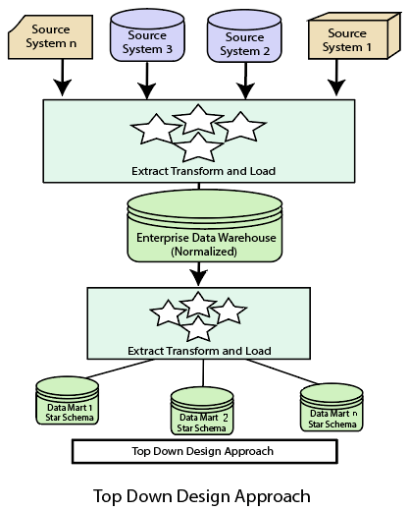

Slide 74
Advantages of top-down design
Data Marts are loaded from the data warehouses.
Developing new data mart from the data warehouse is very easy.
Disadvantages of top-down design
This technique is inflexible to changing departmental needs.
The cost of implementing the project is high.

Slide 75
Bottom-Up Design Approach
In the "Bottom-Up" approach, a data warehouse is described as "a copy of transaction data specifical architecture for query and analysis," term the star schema. In this approach, a data mart is created first to necessary reporting and analytical capabilities for particular business processes (or subjects).
Thus it is needed to be a business-driven approach in contrast to Inmon's data-driven approach.
Data marts include the lowest grain data and, if needed, aggregated data too. Instead of a normalized database for the data warehouse, a denormalized dimensional database is adapted to meet the data delivery requirements of data warehouses.

Slide 76
Using this method, to use the set of data marts as the enterprise data warehouse, data marts should be built with conformed dimensions in mind, defining that ordinary objects are represented the same in different data marts.
The conformed dimensions connected the data marts to form a data warehouse, which is generally called a virtual data warehouse.
The advantage of the "bottom-up" design approach is that it has quick ROI, as developing a data mart, a data warehouse for a single subject, takes far less time and effort than developing an enterprise-wide data warehouse.
Also, the risk of failure is even less. This method is inherently incremental. This method allows the project team to learn and grow.

Slide 77
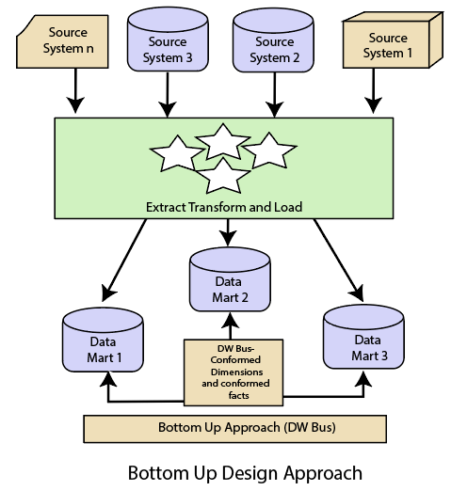

Slide 78
Advantages of bottom-up design
Documents can be generated quickly.
The data warehouse can be extended to accommodate new business units.
It is just developing new data marts and then integrating with other data marts.
Disadvantages of bottom-up design
the locations of the data warehouse and the data marts are reversed in the bottom-up approach design.

Slide 79
Differentiate between Top-Down Design Approach and Bottom-Up Design Approach
Top-Down Design Approach | Bottom-Up Design Approach
Breaks the vast problem into smaller sub problems. | Solves the essential low-level problem and integrates them into a higher one.
Inherently architected- not a union of several data marts. | Inherently incremental; can schedule essential data marts first.
Single, central storage of information about the content. | Departmental information stored.
Centralized rules and control. | Departmental rules and control.
It includes redundant information. | Redundancy can be removed.
It may see quick results if implemented with repetitions. | Less risk of failure, favorable return on investment, and proof of techniques.

Slide 80
Data Warehouse Implementation
The big data which is to be analyzed and handled to draw insights from it will be stored in data warehouses.
These warehouses are run by OLAP servers which require processing of a query with seconds.
So, a data warehouse should need highly efficient cube computation techniques, access methods, and query processing techniques. The core of multidimensional data analysis is the efficient computation of aggregations across many sets of dimensions. In SQL aggregations are referred to as group-by’s.
Each group-by can be represented as a cuboid.
Set of group-by’s forms a lattice of a cuboid defining a data cube.

Slide 81
Efficient Data Cube Computation
The compute cube Operator and the Curse of Dimensionality
The compute cube operator computes aggregates over all subsets of the dimensions specified in the operation.
It requires excessive storage space, especially for a large number of dimensions.
A data cube is a lattice of cuboids.
Suppose that we create a data cube for ProElectronics(Company) sales that contains the following: city, item, year, and sales_in_dollars.
Compute the sum of sales, grouping by city, and item. Compute the sum of sales, grouping by city. Compute the sum of sales, grouping by item.
What is the total number of cuboids, or group-by’s, that can be computed for this data cube? Three attributes:
city, item, year (dimensions), sales_in_dollars (measure).
The total number of cuboids or group-by’s computed for this cube is 2^3=8.

Slide 82
Group-by’s: {(city,item,year), (city, item), (city, year), (item, year), (city), (item), (year),()}. () : group-by is empty i.e. the dimensions are not grouped.
The base cuboid contains all three dimensions.
Apex cuboid is empty.
On-line analytical processing may need to access different cuboids for different queries.
So we have to compute all or at least some of the cuboids in the data cube in advance.
Precomputation leads to fast response time and avoids some redundant computation.
A major challenge related to precomputation would be storage space if all the cuboids in the data cube are computed, especially when the cube has many dimensions.
The storage requirements are even more excessive when many of the dimensions have associated concept hierarchies, each with multiple levels.
This problem is referred to as the Curse of Dimensionality.

Slide 83
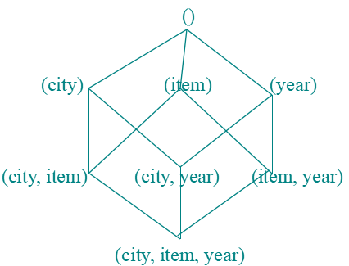
Cube Operation
Cube definition and computation in DMQL
define cube sales_cube[ city, item, year] (sales_in_dollars)
compute cube sales_cube
Transform it into a SQL-like language (with a new operator cube by, introduced by Gray et al.’96)
SELECT item, city, year, SUM (amount) FROM SALES CUBE BY item, city, year
Data cube can be viewed as a lattice of cuboids
The bottom-most cuboid is the base cuboid.
The top-most cuboid (apex) contains only one cell.
How many cuboids in an n-dimensional cube with L levels? (T=SUM(Li+1))
For example, the time dimension as specified above has 4 conceptual levels, or 5 if we include the virtual level all.
If the cube has 10 dimensions and each dimension has 5 levels (including all), the total number of cuboids that can be generated is 510 9.8x106.

Slide 84
Data Cube Materialization
There are three choices for data cube materialization given a base cuboid.
No Materialization
Full Materialization
Partial Materialization
How to select which materialization to use
Identify the subsets of cuboids or subcubes to materialize.
Exploit the materialized cuboids or subcubes during query processing.
Efficiently update the materialized cuboids or subcubes during load and refresh.
Selection of which cuboids to materialize
Based on the size, queries in the workload, accessing cost, their frequencies, etc.
Indexing OLAP Data: Bitmap Index
First of all, create an index table on a particular column of the table.
Then each value in the column has got a bit vector: bit-op is fast.
The length of the bit vector: # of records in the base table.
The i-th bit is set if the i-th row of the base table has the value for the indexed column.
It's not suitable for high cardinality domains.

Slide 85
Indexing OLAP Data: Join Indices
The join indexing method gained popularity from its use in relational database query processing.
The join index records can identify joinable tuples without performing costly join operations.
Join indexing is especially useful for maintaining the relationship between a foreign key and its matching primary keys, from the joinable relation.
Suppose that there are 360-time values, 100 items, 50 branches, 30 locations, and 10 million sales tuples in the sales star data cube. If the sales fact table has recorded sales for only 30 items, the remaining 70 items will obviously not participate in joins. If join indices are not used, additional I/Os have to be performed to bring the joining portions of the fact table and dimension tables together.
To further speed up query processing, the join indexing, and bitmap indexing methods can be integrated to form bitmapped join indices.
Microsoft SQL Server and Sybase IQ support bitmap indices. Oracle 8 uses bitmap and join indices.

Slide 86
Efficient Processing OLAP Queries
The purpose of materializing cuboids and constructing OLAP index structures is to speed up the query processing in data cubes.
Given materialized views, query processing should proceed as follows:
Determine which operations should be performed on the available cuboids:
Transform drill, roll, etc. into the corresponding SQL and/or OLAP operations, e.g., dice = selection + projection.
Determine to which materialized cuboid(s) the relevant operations should be applied:
Suppose that the query to be processed be on {brand, province_or_state} with the selection constant “year = 2004”, and
there are 4 materialized cuboids available: {year, item_name, city}, {year, brand, country}, {year, brand, province_or_state}, {item_name, province_or_state} where year = 2004

Slide 87
Data Generalization by Attribute-oriented Induction approach
Attribute Oriented Induction In Data Mining - Data Characterization
Attribute-Oriented Induction
The Attribute-Oriented Induction (AOI) approach to data generalization and summarization – based characterization was first proposed in 1989 (KDD ‘89 workshop) a few years before the introduction of the data cube approach.
The data cube approach can be considered as a data warehouse – based, pre computational – oriented, materialized approach.
It performs off-line aggregation before an OLAP or data mining query is submitted for processing.
On the other hand, the attribute oriented induction approach, at least in its initial proposal, a relational database query – oriented, generalized – based, on-line data analysis technique.
However, there is no inherent barrier distinguishing the two approaches based on online aggregation versus offline precomputation.
Some aggregations in the data cube can be computed on-line, while off-line precomputation of multidimensional space can speed up attribute-oriented induction as well.
It was proposed in 1989 (KDD ‘89 workshop).
It is not confined to categorical data nor particular measures.

Slide 88
How it is done?
Collect the task-relevant data( initial relation) using a relational database query
Perform generalization by attribute removal or attribute generalization.
Apply aggregation by merging identical, generalized tuples and accumulating their respective counts.
Reduces the size of the generalized data set.
Interactive presentation with users.
Basic Principles Of Attribute Oriented Induction
Data focusing:
Analyzing task-relevant data, including dimensions, and the result is the initial relation.
Attribute-removal:
To remove attribute A if there is a large set of distinct values for A but (1) there is no generalization operator on A, or (2) A’s higher-level concepts are expressed in terms of other attributes.

Slide 89
Attribute-generalization:
If there is a large set of distinct values for A, and there exists a set of generalization operators on A, then select an operator and generalize A.
Attribute-threshold control:
Typical 2-8, specified/default.
Generalized relation threshold control (10-30):
To control the final relation/rule size.
Algorithm for Attribute Oriented Induction
InitialRel:
It is nothing but query processing of task-relevant data and deriving the initial relation.
PreGen:
It is based on the analysis of the number of distinct values in each attribute and to determine the generalization plan for each attribute: removal? or how high to generalize?
PrimeGen:
It is based on the PreGen plan and performing the generalization to the right level to derive a “prime generalized relation” and also accumulating the counts. Presentation:
User interaction: (1) adjust levels by drilling, (2) pivoting, (3) mapping into rules, cross tabs, visualization presentations.

Slide 90
Example
Let's say there is a University database that is to be characterized, for that its corresponding DMQL will be
use University_DB mine characteristics as “Science_Students” in relevance to name, gender, major, birth_place, birth_date, residence, phone_no, GPA from student
Its corresponding SQL statement can be:
Select name, gender, major, birth_place, birth_date, residence, phone_no, GPA from student where status in {“Msc”, “MBA”, “Ph.D.” }
Now for this database let's create a characterized view:
InitialRel:
From this table, we are querying task-relevant data.
From this table, we also removed a few attributes like name and phoneno, because they make no sense in concluding insights.

Slide 91
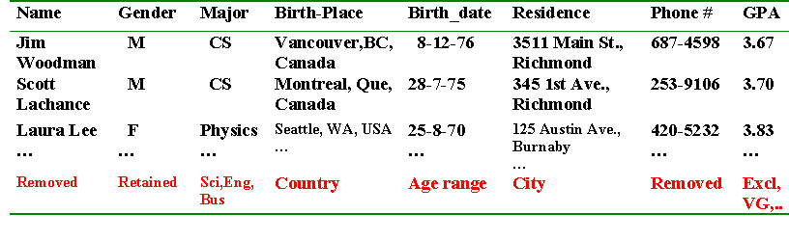
PreGen
Now, we have generalized these results by removing a few attributes and retaining important attributes.
And also we have generalized a few attributes by naming them "Country" rather than "Birth_Place", "Age Range" rather than "Birth_data", "City" rather than "Residence" and so on as per the table given below.

Slide 92
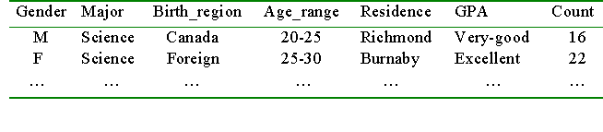
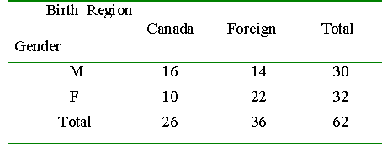
PrimeGen
Based on the PreGen plan we've performed generalization to the right level to derive a “prime generalized relation” and also we've accumulated the counts.
Final Results
Now we've and analyzed and concluded our final generalized results as shown below.

Slide 93
Presentation Of Results
Generalized relation:
Relations where some or all attributes are generalized, with counts or other aggregation values accumulated.
Cross-tabulation:
Mapping results into cross-tabulation form (similar to contingency tables).
Visualization techniques:
Pie charts, bar charts, curves, cubes, and other visual forms.
Quantitative characteristic rules:
Mapping generalized results in characteristic rules with quantitative information associated with it.

Slide 94
Data Cube Computation Methods
Data generalization is a process that abstracts a large set of task-relevant data in a database from a relatively low conceptual level to higher conceptual levels. Users like the ease and flexibility of having large data sets summarized in concise and succinct terms, at different levels of granularity, and from different angles. Such data descriptions help provide an overall picture of the data at hand.
Efficient Methods for Data Cube Computation
Data cube computation is an essential task in data warehouse implementation. The pre computation of all or part of a data cube can greatly reduce the response time and enhance the performance of on-line analytical processing. However, such computation is challenging because it may require substantial computational time and storage space. This section explores efficient methods for data cube computation.
A Road Map for the Materialization of Different Kinds of Cubes
Data cubes facilitate the on-line analytical processing of multidimensional data. For completeness, we begin with a review of the basic terminology involving data cubes. We also introduce a cube cell notation that is useful for describing data cube computation methods.

Slide 95
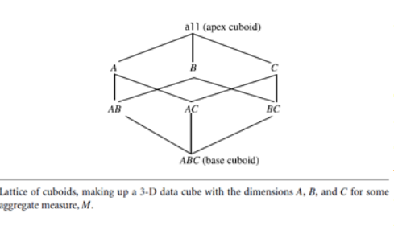
Cube Materialization: Full Cube, Iceberg Cube, Closed Cube, and Shell Cube
The above figure shows a 3-D data cube for the dimensions A, B, and C, and an aggregate measure, M. A data cube is a lattice of cuboids. Each cuboid represents a group-by. ABC is the base cuboid, containing all three of the dimensions. Here, the aggregate measure, M, is computed for each possible combination of the three dimensions. The base cuboid is the least generalized of all of the cuboids in the data cube. The most generalized cuboid is the apex cuboid, commonly represented as all. It contains one value—it aggregates measure M for all of the tuples stored in the base cuboid. To drill down in the data cube, we move from the apex cuboid, downward in the lattice. To roll up, we move from the base cuboid, upward. For the purposes of our discussion in this chapter, we will always use the term data cube to refer to a lattice of cuboids rather than an individual cuboid.
A cell in the base cuboid is a base cell. A cell from a non base cuboid is an aggregate cell. An aggregate cell aggregates over one or more dimensions, where each aggregated dimension is indicated by a “
” in the cell notation. Suppose we have an n-dimensional data cube. Let a = (a1, a2, : : : , an, measures) be a cell from one of the cuboids making up the data cube.We say that a is an m-dimensional cell (that is, from an m-dimensional cuboid) if exactly m (m ≤ n) values among fa1, a2, : : : , ang are not “ * ”. If m = n, then a is a base cell; otherwise, it is an aggregate cell (i.e., where m < n).

Slide 96
General Strategies for Cube Computation: With different kinds of cubes as described above, we can expect that there are a good number of methods for efficient computation. In general, there are two basic data structures used for storing cuboids. Relational tables are used as the basic data structure for the implementation of relational OLAP (ROLAP), while multidimensional arrays are used as the basic data structure in multidimensional OLAP (MOLAP). Although ROLAP and MOLAP may each explore different cube computation techniques, some optimization “tricks” can be shared among the different data representations. The following are general optimization techniques for the efficient computation of data cubes.
Optimization Technique 1: Sorting, hashing, and grouping. Sorting, hashing, and grouping operations should be applied to the dimension attributes in order to reorder and cluster related tuples.
In cube computation, aggregation is performed on the tuples (or cells) that share the same set of dimension values. Thus it is important to explore sorting, hashing, and grouping operations to access and group such data together to facilitate computation of such aggregates. For example, to compute total sales by branch, day, and item, it is more efficient to sort tuples or cells by branch, and then by day, and then group them according to the item name. Efficient implementations of such operations in large data sets have been extensively studied in the database research community. Such implementations can be extended to data cube computation.

Slide 97
Multiway Array Aggregation for Full Cube Computation
The Multiway Array Aggregation (or simply MultiWay) method computes a full data cube by using a multidimensional array as its basic data structure. It is a typical MOLAP approach that uses direct array addressing, where dimension values are accessed via the position or index of their corresponding array locations. Hence, MultiWay cannot perform any value-based reordering as an optimization technique. A different approach is developed for the array-based cube construction, as follows:
1. Partition the array into chunks. A chunk is a sub cube that is small enough to fit into the memory available for cube computation. Chunking is a method for dividing an n-dimensional array into small n-dimensional chunks, where each chunk is stored as an object on disk. The chunks are compressed so as to remove wasted space resulting from empty array cells (i.e., cells that do not contain any valid data, whose cell count is zero). For instance, “chunkID offset” can be used as a cell addressing mechanism to compress a sparse array structure and when searching for cells within a chunk. Such a compression technique is powerful enough to handle sparse cubes, both on disk and in memory.
2. Compute aggregates by visiting (i.e., accessing the values at) cube cells. The order in which cells are visited can be optimized so as to minimize the number of times that each cell must be revisited, thereby reducing memory access and storage costs. The trick is to exploit this ordering so that partial aggregates can be computed simultaneously, and any unnecessary revisiting of cells is avoided.
Because this chunking technique involves “overlapping” some of the aggregation computations, it is referred to as multiway array aggregation. It performs simultaneous aggregation—that is, it computes aggregations simultaneously on multiple dimensions.

Slide 98
BUC: Computing Iceberg Cubes from the Apex Cuboid Downward
BUC is an algorithm for the computation of sparse and iceberg cubes. Unlike Multi Way, BUC constructs the cube from the apex cuboid toward the base cuboid. This allows BUC to share data partitioning costs. This order of processing also allows BUCto prune during construction, using the Apriori property.
Figure shows a lattice of cuboids, making up a 3-D data cube with the dimensions A, B, and C. The apex (0-D) cuboid, representing the concept all is at the top of the lattice. This is the most aggregated or generalized level. The 3-D base cuboid, ABC, is at the bottom of the lattice. It is the least aggregated (most detailed or specialized) level. This representation of a lattice of cuboids, with the apex at the top and the base at the bottom, is commonly accepted in data warehousing. It consolidates the notions of drill-down (where we can move from a highly aggregated cell to lower, more detailed cells) and roll-up (where we can move from detailed, low-level cells to higher level, more aggregated cells).
BUC stands for “Bottom-Up Construction.” However, according to the lattice convention described above and used throughout this book, the order of processing of BUC is actually top-down! The authors of BUC view a lattice of cuboids in the reverse order, with the apex cuboid at the bottom and the base cuboid at the top. In that view, BUC does bottom-up construction. However, because we adopt the application worldview where drill-down refers to drilling from the apex cuboid down toward the base cuboid, the exploration process of BUC is regarded as top-down. BUC’s exploration for the computation of a 3-D data cube is shown in Figure 4.5.
The BUC algorithm is shown in Figure 4.6. We first give an explanation of the algorithm and then follow up with an example. Initially, the algorithm is called with the input relation (set of tuples). BUC aggregates the entire input (line 1) and writes

Slide 99
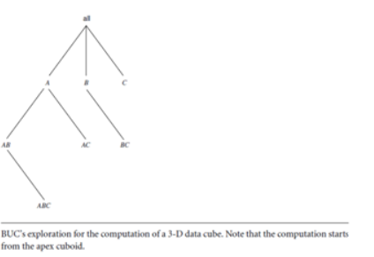
Algorithm: BUC. Algorithm for the computation of sparse and iceberg cubes.

Slide 100
Star-Cubing: Computing Iceberg Cubes Using a Dynamic Star-tree Structure
the Star-Cubing algorithm for computing iceberg cubes. Star-Cubing combines the strengths of the other methods we have studied up to this point. It integrates top-down and bottom-up cube computation and explores both multidimensional aggregation (similar to MultiWay) and Apriori-like pruning (similar to BUC). It operates from a data structure called a star-tree, which performs lossless data compression, thereby reducing the computation time and memory requirements.
The Star-Cubing algorithm explores both the bottom-up and top-down computation models as follows: On the global computation order, it uses the bottom-up model. However, it has a sub layer underneath based on the top-down model, which explores the notion of shared dimensions, as we shall see below. This integration allows the algorithm to aggregate onmultiple dimensions while still partitioning parent group-by’s and pruning child group-by’s that do not satisfy the iceberg condition.
Star-Cubing’s approach is illustrated in Figure 4.8 for the computation of a 4-D data cube. If we were to follow only the bottom-up model (similar to Multiway), then the cuboids marked as pruned by Star-Cubing would still be explored. Star-Cubing is able to prune the indicated cuboids because it considers shared dimensions. ACD=A means cuboid ACD has shared dimension A, ABD=AB means cuboid ABD has shared dimension AB, ABC=ABC means cuboid ABC has shared dimension ABC, and so on. This comes from the generalization that all the cuboids in the subtree rooted at ACD include dimension A, all those rooted at ABD include dimensions AB, and all those rooted at ABC include dimensions ABC (even though there is only one such cuboid). We call these common dimensions the shared dimensions of those particular sub trees.

Slide 101
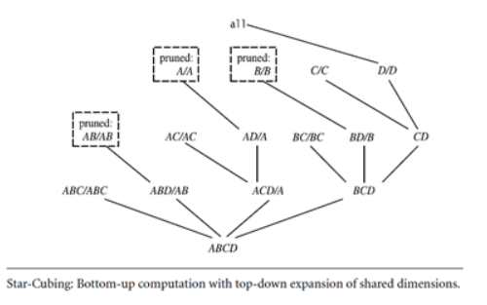
The introduction of shared dimensions facilitates shared computation. Because the shared dimensions are identified early on in the tree expansion, we can avoid re computing them later. For example, cuboid AB extending from ABD in Figure 4.8 would actually be pruned because AB was already computed in ABD=AB. Similarly, cuboid A extending from AD would also be pruned because it was already computed in ACD=A.
Shared dimensions allow us to do A priori-like pruning if the measure of an iceberg cube, such as count, is anti monotonic; that is, if the aggregate value on a shared dimension does not satisfy the iceberg condition, then all of the cells descending from this shared dimension cannot satisfy the iceberg condition either. Such cells and all of their descendants can be pruned, because these descendant cells are, by definition, more specialized (i.e., contain more dimensions) than those in the shared dimension(s). The number of tuples covered by the descendant cells will be less than or equal to the number of tuples covered by the shared dimensions. Therefore, if the aggregate value on a shared dimension fails the iceberg condition, the descendant cells cannot satisfy it either.

Slide 102
Pre-computing Shell Fragments for Fast High-Dimensional OLAP
Introduction:
Recall the reason that we are interested in pre-computing data cubes: Data cubes facilitate fast on-line analytical processing (OLAP) in a multidimensional data space. However, a full data cube of high dimensionality needs massive storage space and unrealistic computation time.
Iceberg cubes provide a more feasible alternative, as we have seen wherein the iceberg condition is used to specify the computation of only a subset of the full cube’s cells. However, although an iceberg cube is smaller and requires less computation time than its corresponding full cube, it is not an ultimate solution. For one, the computation and storage of the iceberg cube can still be costly. For example, if the
Algorithm: Star-Cubing. Compute iceberg cubes by Star-Cubing.
Input:
R: a relational table
min support: minimum support threshold for the iceberg condition (taking count as the measure).
Output: The computed iceberg cube.
Method: Each star-tree corresponds to one cuboid tree node, and vice versa.
BEGIN
scan R twice, create star-table S and star-tree T;
output count of T.root;
call starcubing(T, T.root);
END

Slide 103
procedure starcubing(T, cnode)// cnode: current node
{
1. for each non-null child C of T’s cuboid tree
2. insert or aggregate cnode to the corresponding
3. position or node in C’s star-tree;
4. if (cnode.count min support) then f
5. if (cnode 6= root) then
6. output cnode.count;
7. if (cnode is a leaf) then
8. output cnode.count;
9. else { // initiate a new cuboid tree
10. create CC as a child of T’s cuboid tree;
11. let TC be CC’s star-tree;
12. TC:root0s count = cnode:count;
13. }
14. }
15. if (cnode is not a leaf) then
16. starcubing(T, cnode.first child);
17. if (CC is not null) then f
18. starcubing(TC;TC:root);
19. remove CC from T’s cuboid tree; g
20. if (cnode has sibling) then
21. starcubing(T, cnode.sibling);
22. remove T;
23. }

